Slide 1
Genome Topology (Hi-C)
Caleb Lareau

Slide 2
Overview
Motivation
Timeline
Authors
Key Concepts
In situ
Domains/boundaries
Subcompartments
Loops
Resolution
Rao et al.

Slide 3
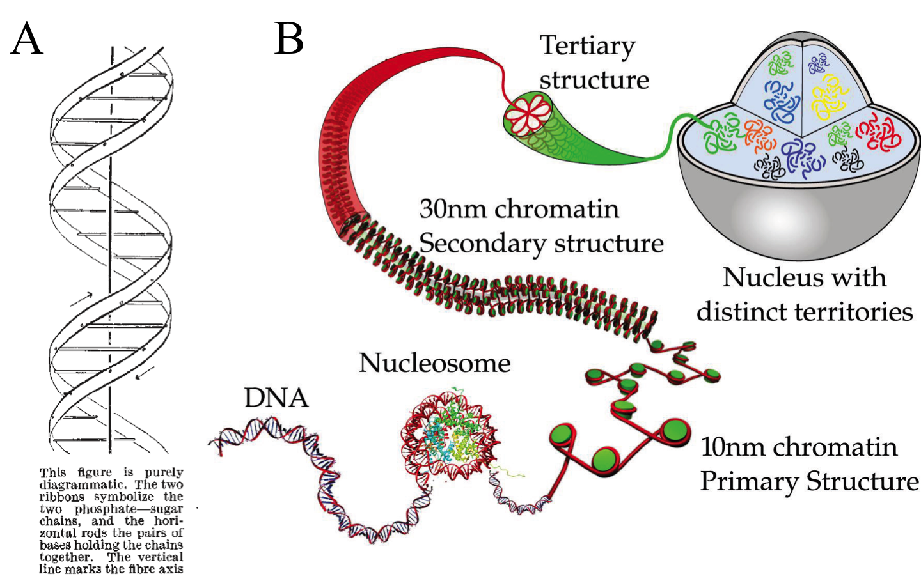

Slide 4
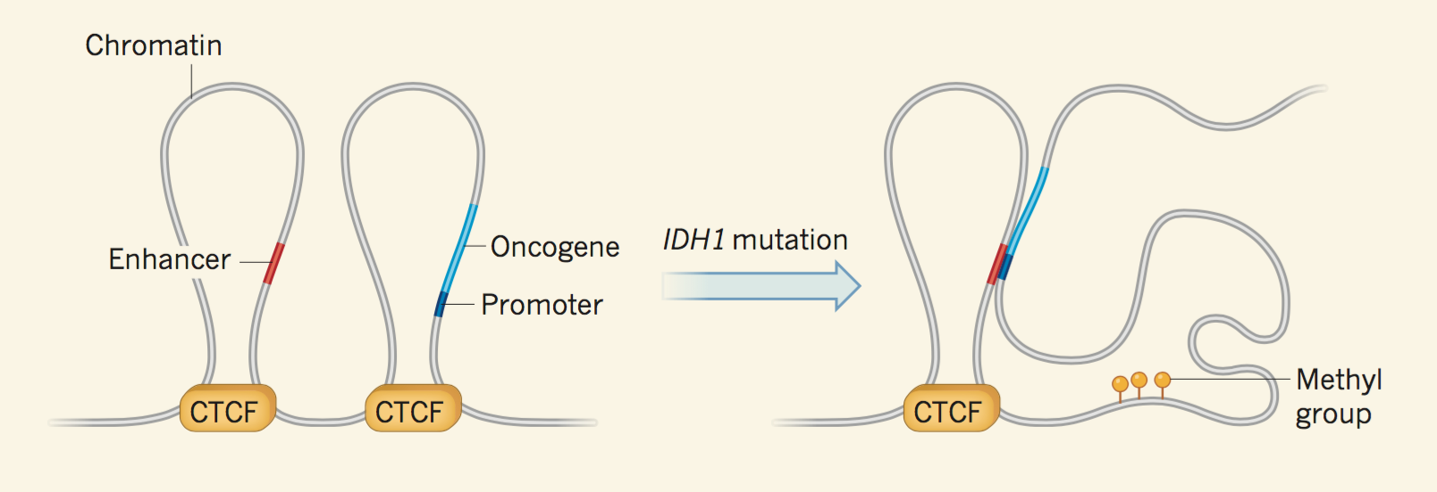
Flavahan et al 2016 (Caleb will present October 26)

Slide 5
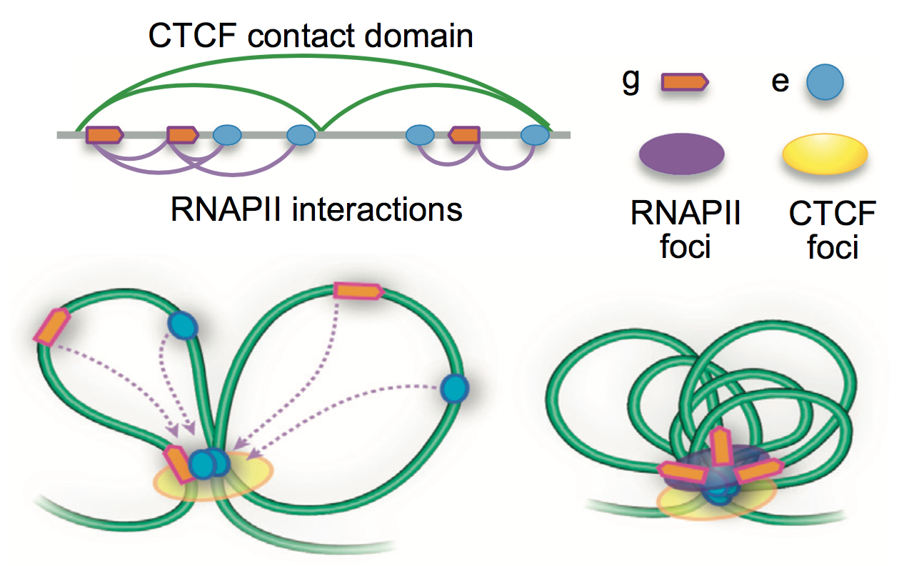

Slide 6
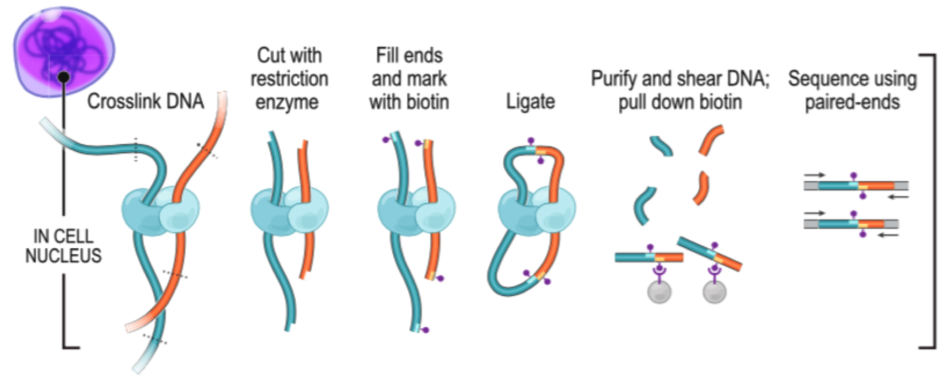
Hi-C

Slide 7
Draw Hi-C Bin/Seq Example

Slide 8
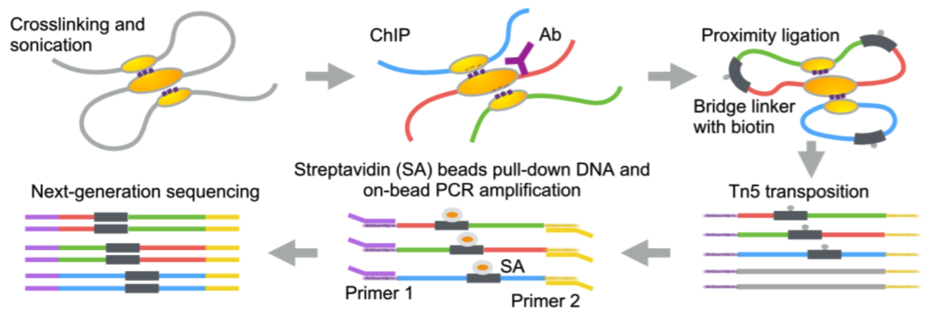
ChIA-PET

Slide 9
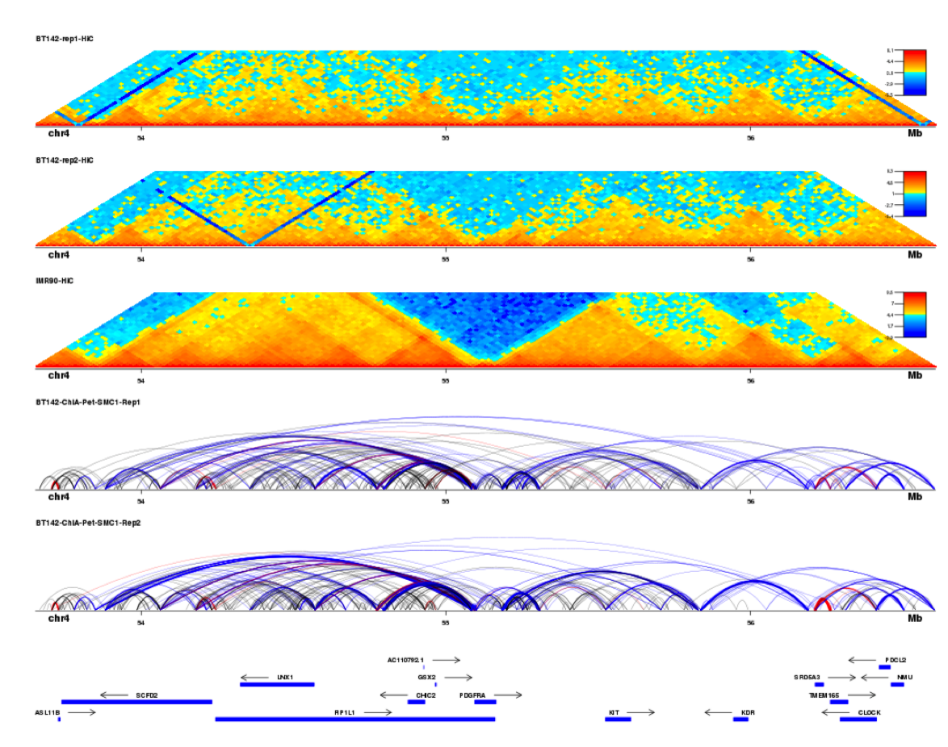
Hi-C
ChIA-PET

Slide 10
Shameless plug
dnalandscaper.aryeelab.org

Slide 11
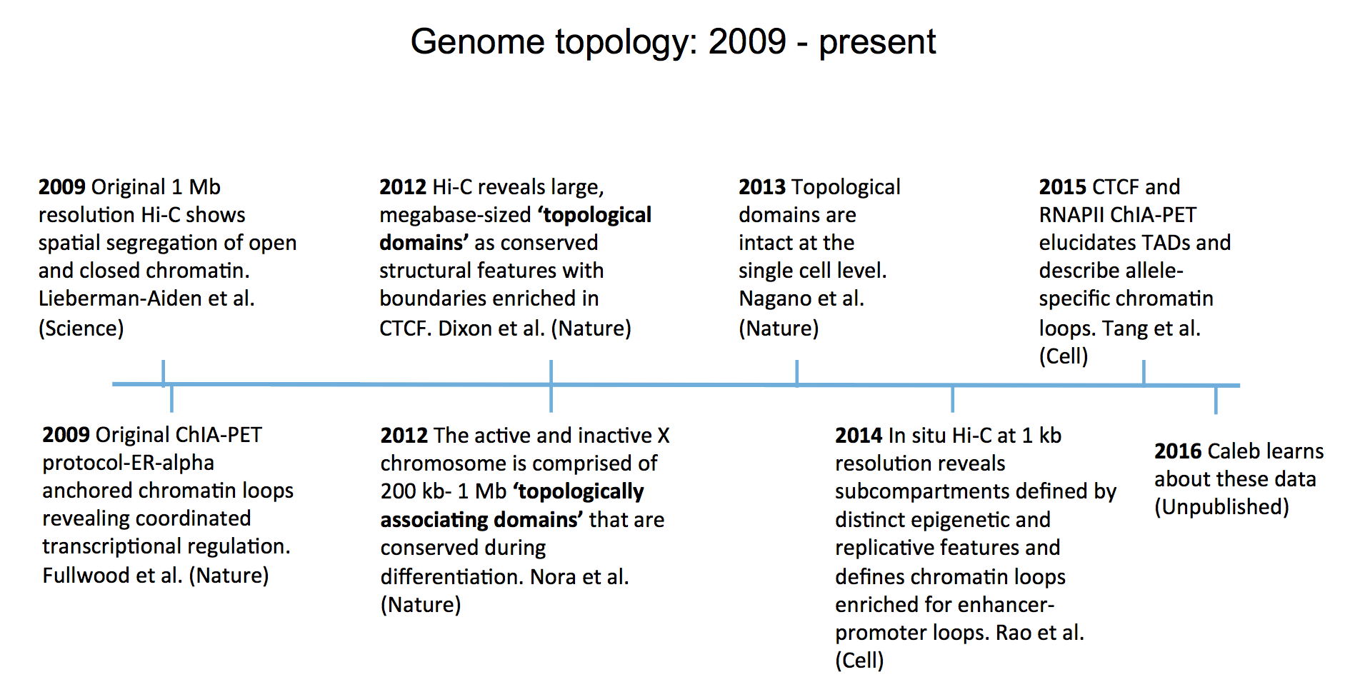
timeline
Today

Slide 12
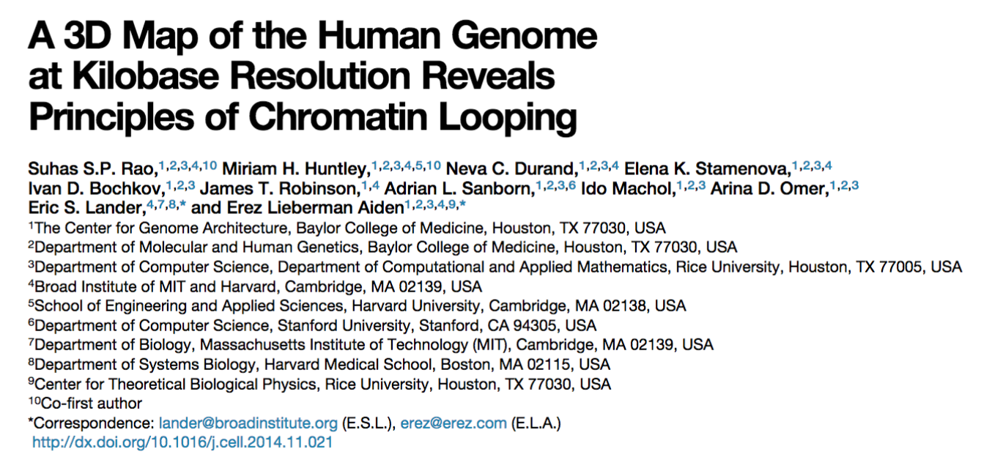

Slide 13
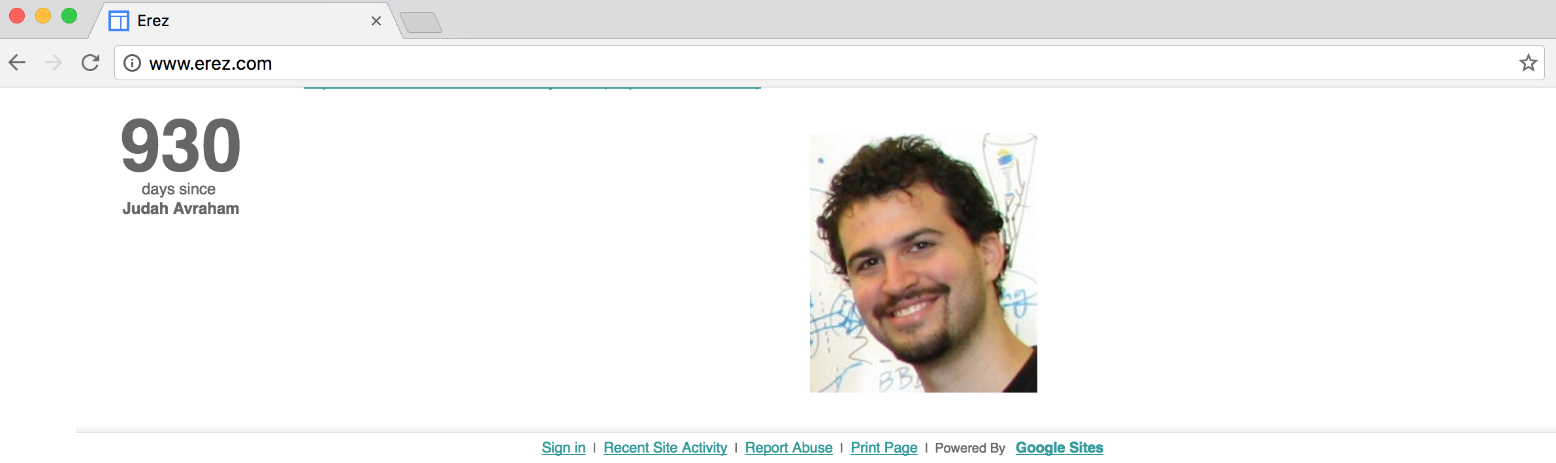
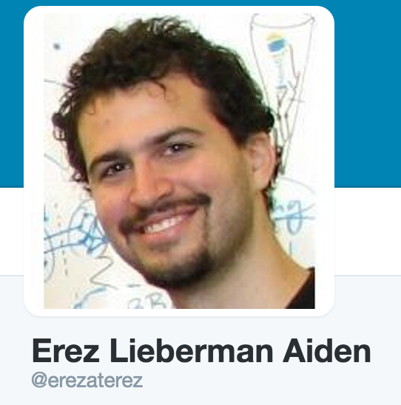

Slide 14
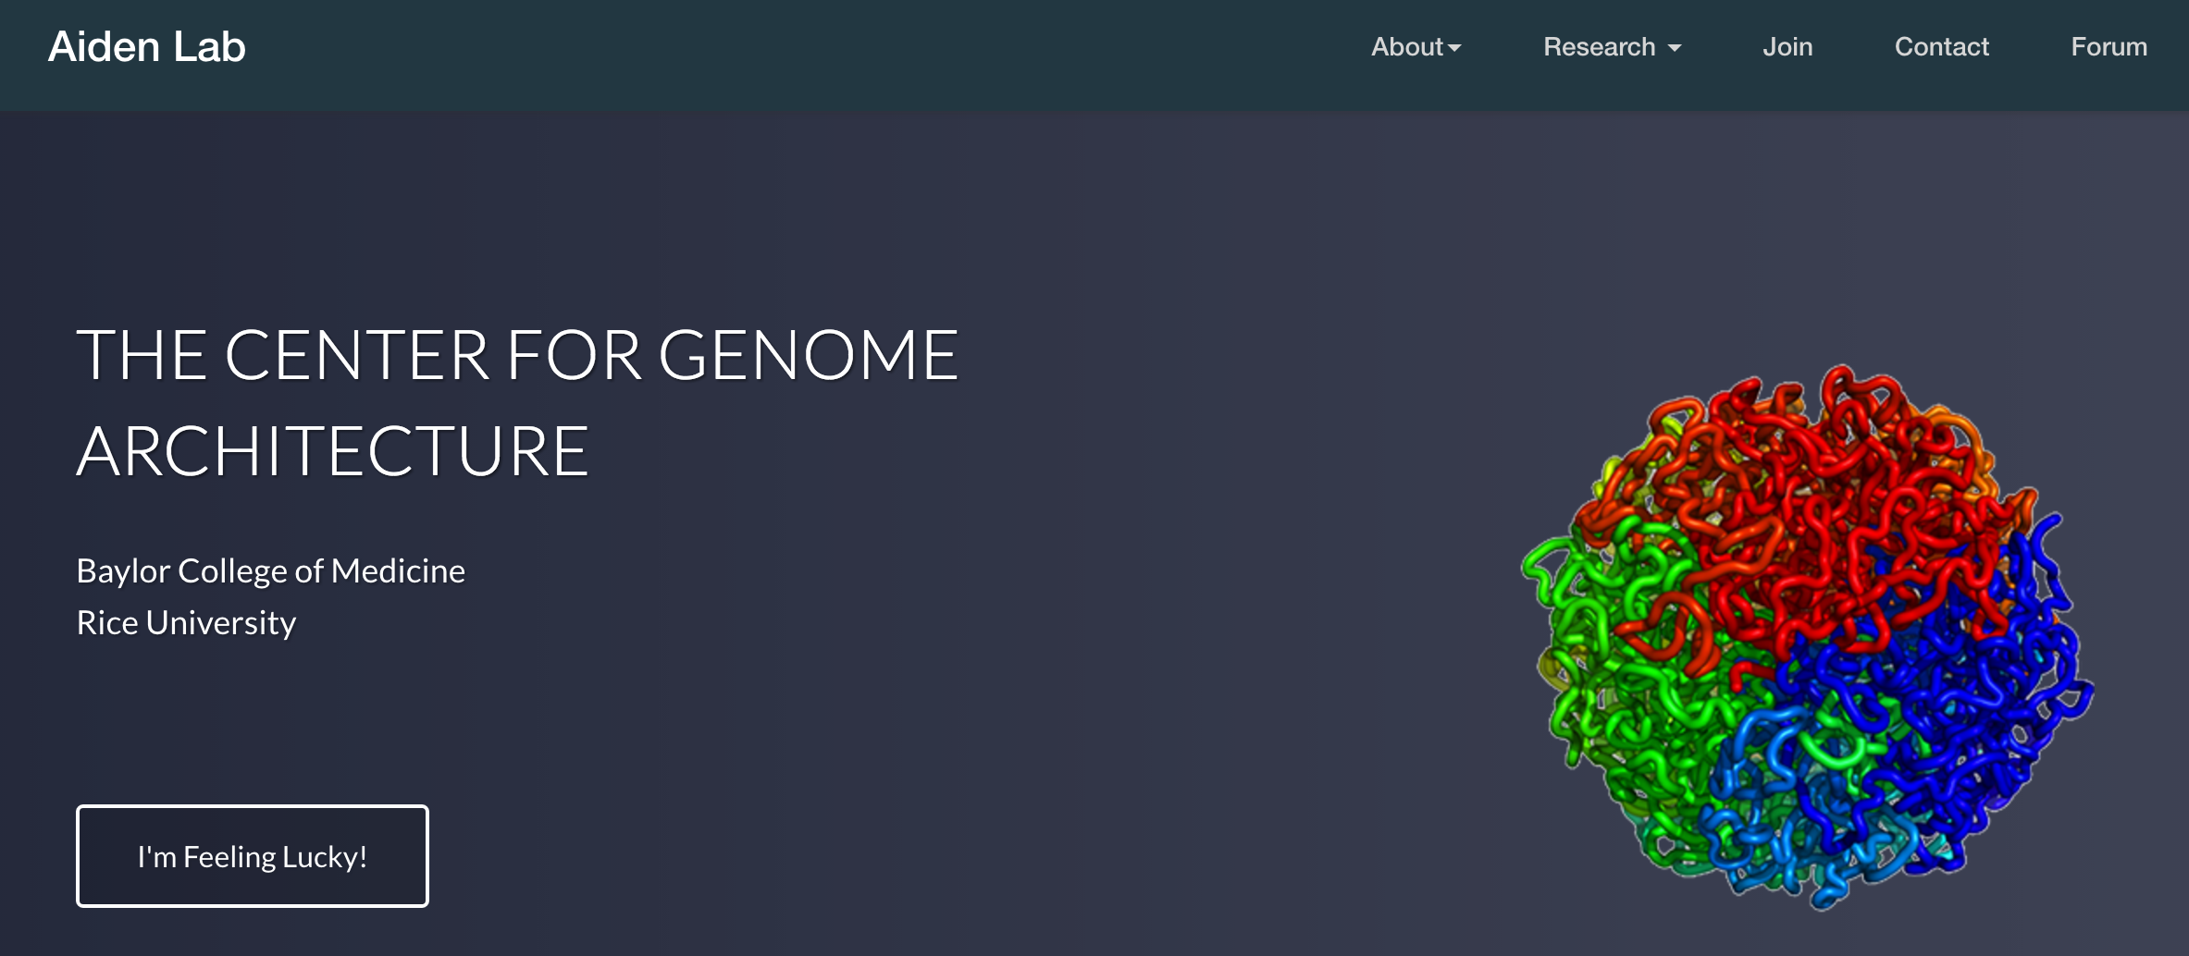

Slide 15
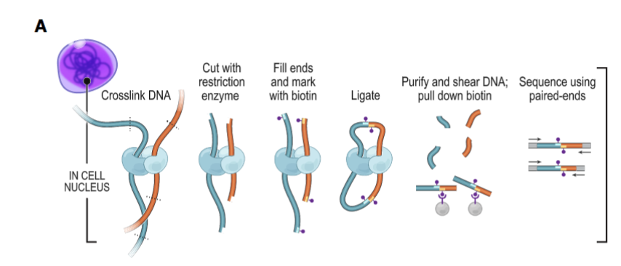
Importance of in situ
In situ

Slide 16
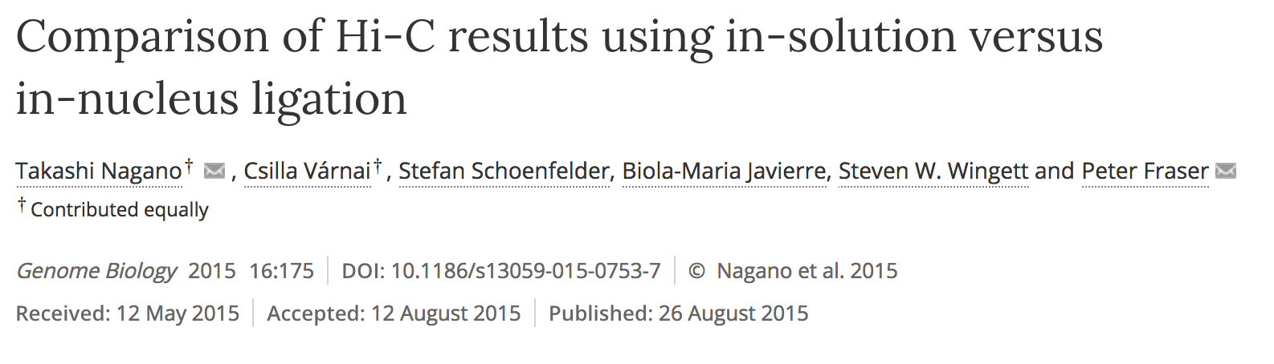
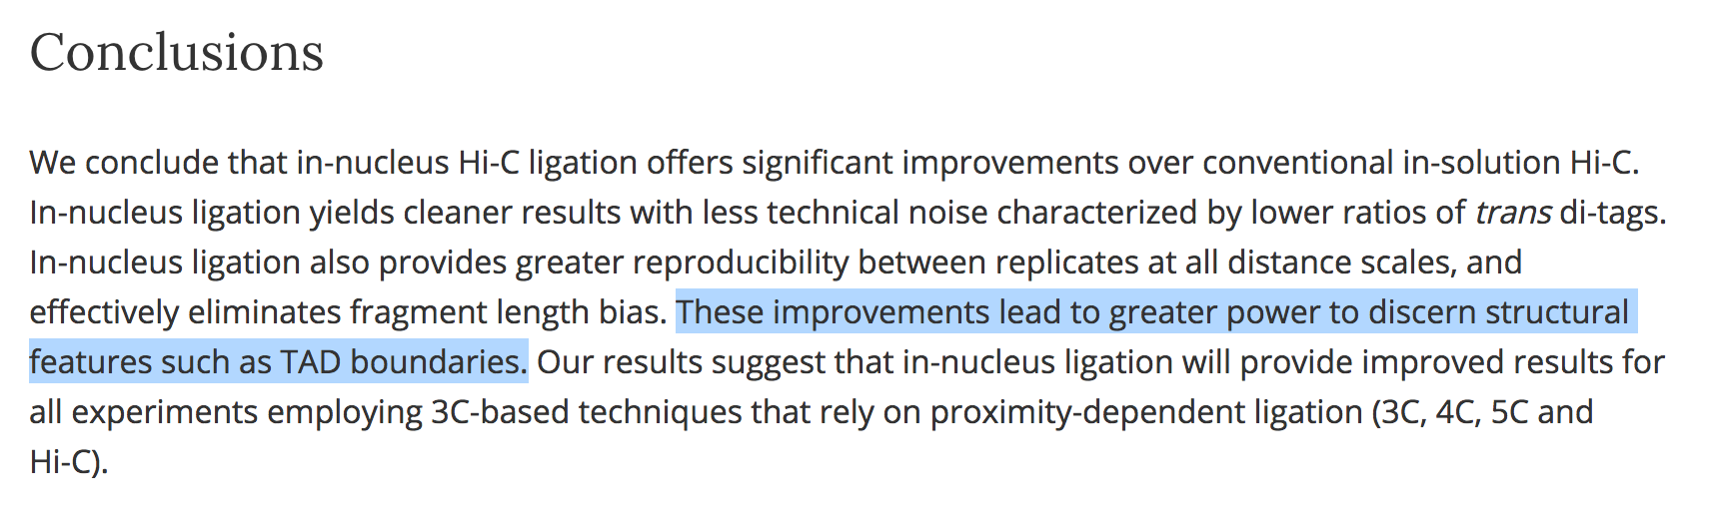

Slide 17
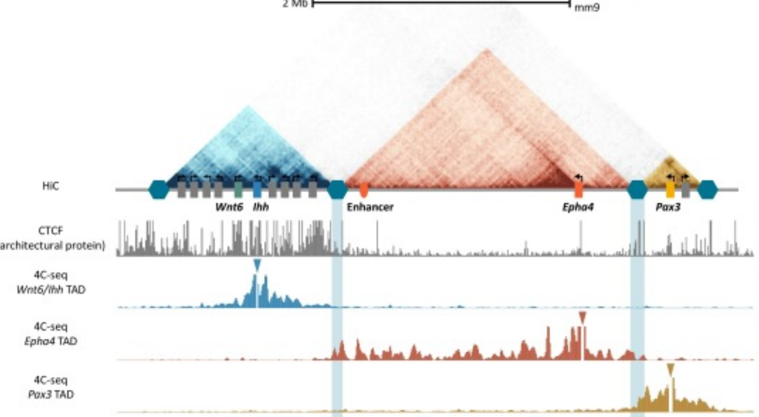

Slide 19
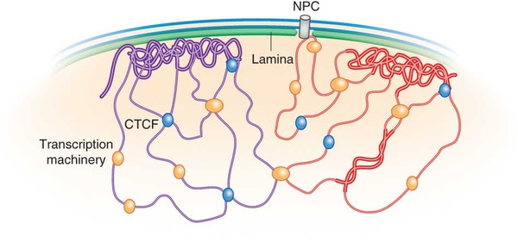
Subcompartments/Lamina
Repressed

Slide 20
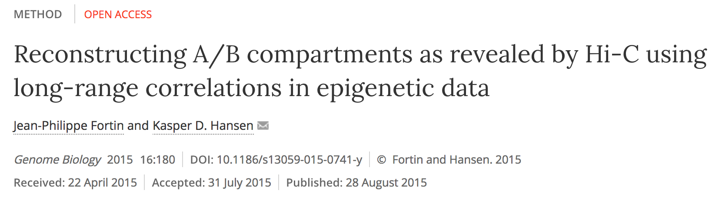
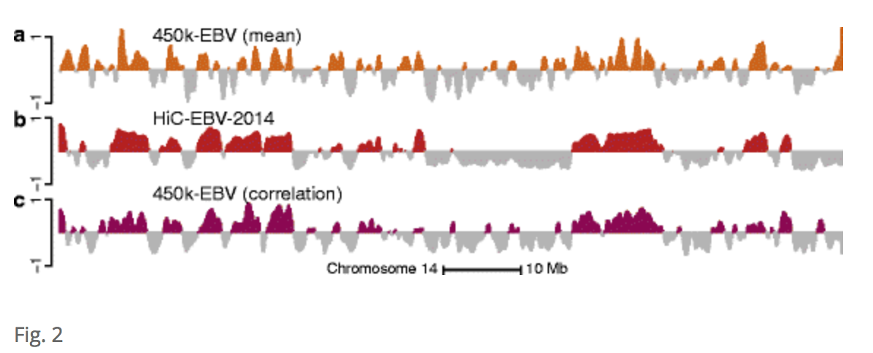

Slide 22
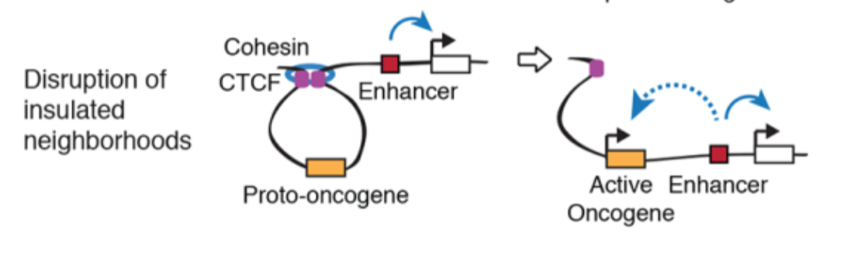
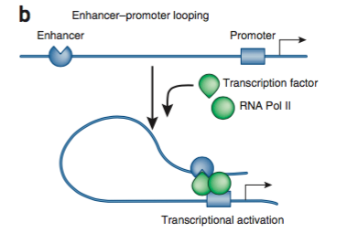

Slide 23
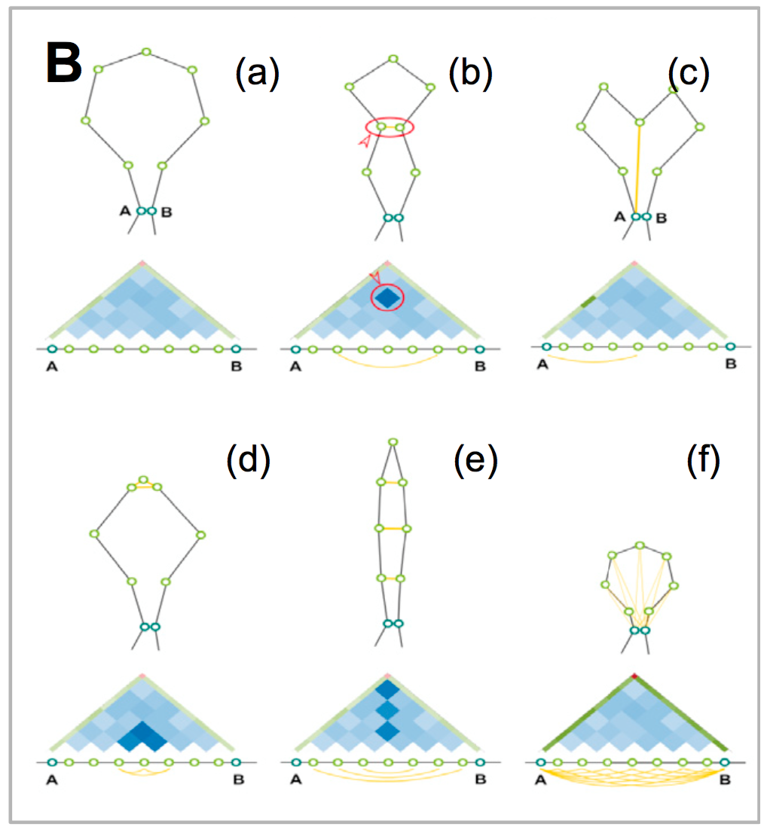
Loops

Slide 24
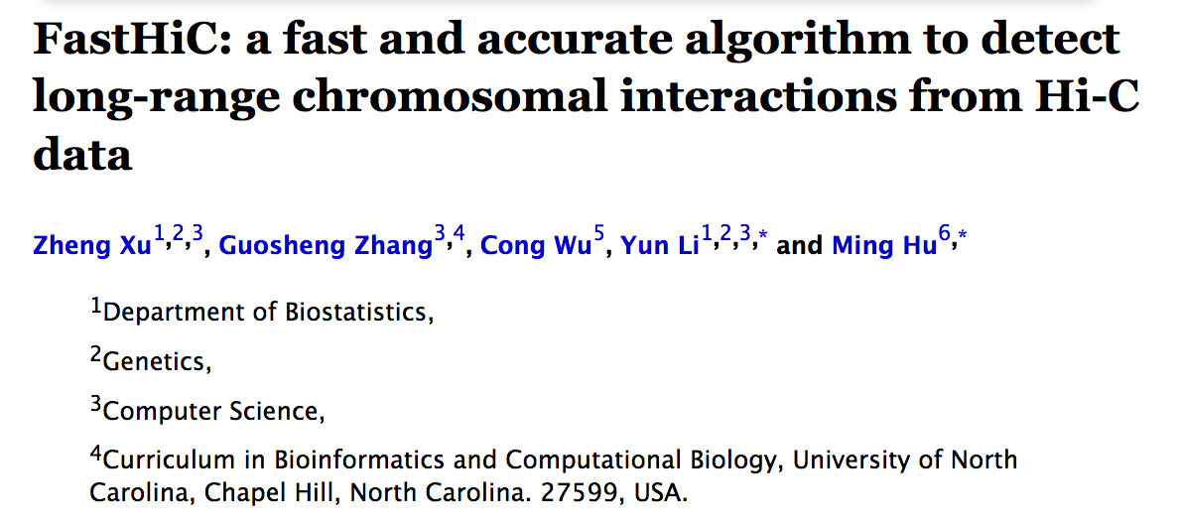
Loops

Slide 25
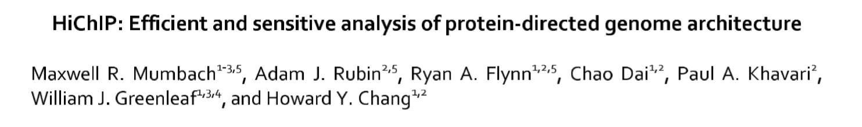
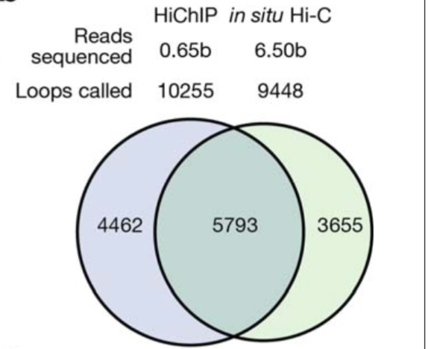
Loops

Slide 26
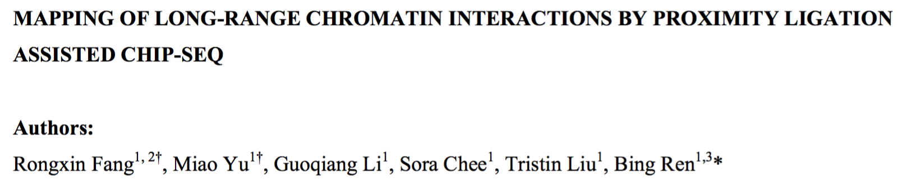
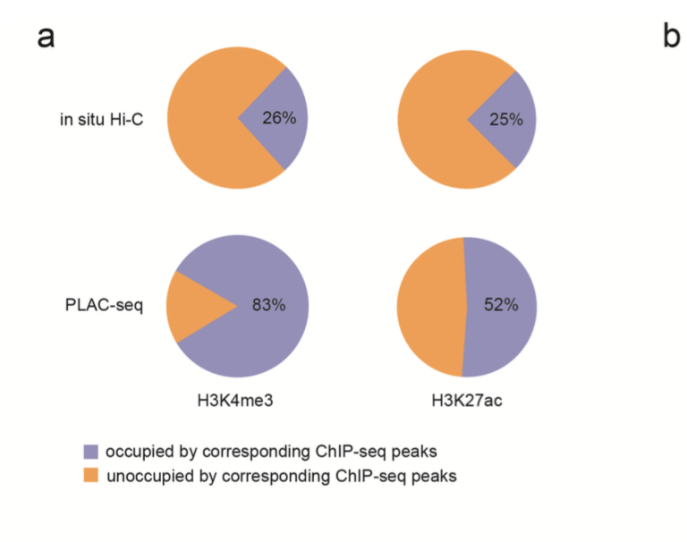

Slide 27
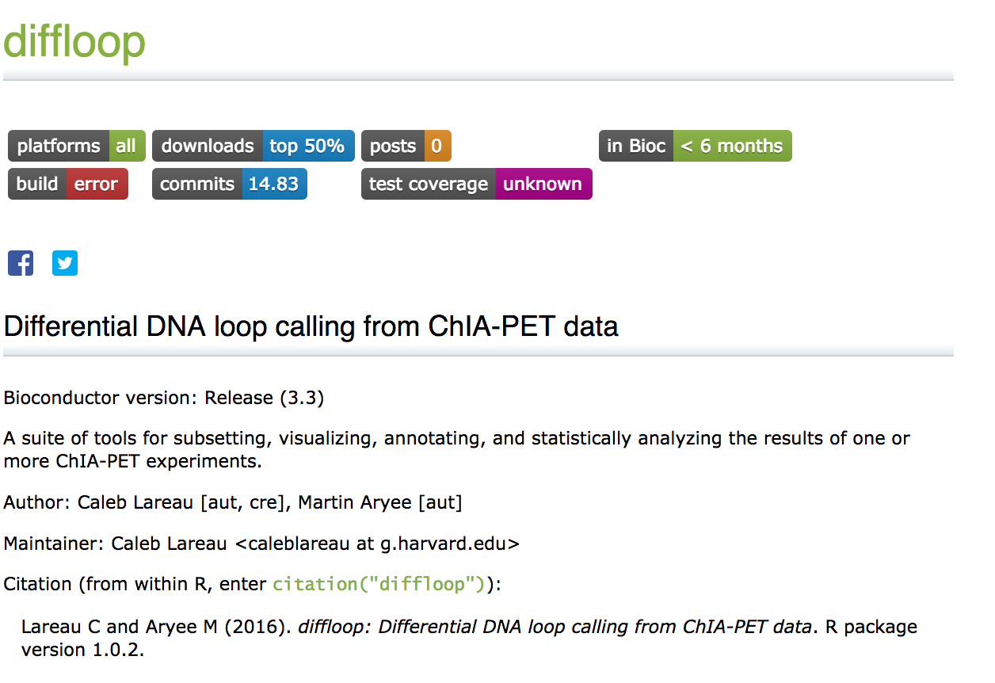
Shameless Plug 2

Slide 28
Definition of Resolution
A Hi-C map is a list of DNA-DNA contacts produced by a Hi-C experiment. By partitioning the linear genome into ‘‘loci’’ of fixed size (e.g., bins of 1 Mb or 1 kb), the Hi-C map can be represented as a ‘‘contact matrix’’ M, where the entry Mi,j is the number of contacts observed between locus Li and locus Lj. (A ‘‘contact’’ is a read pair that remains after we exclude reads that are duplicates, that correspond to unligated fragments, or that do not align uniquely to the genome.) The contact matrix can be visualized as a heatmap, whose entries we call ‘‘pixels.’’ An ‘‘interval’’ refers to a set of consecutive loci; the contacts between two intervals thus form a ‘‘rectangle’’ or ‘‘square’’ in the contact matrix. We define the ‘‘matrix resolution’’ of a Hi-C map as the locus size used to construct a particular contact matrix and the ‘‘map resolution’’ as the smallest locus size such that 80% of loci have at least 1,000 contacts.

Slide 30
Figure 1
In situ

Slide 31
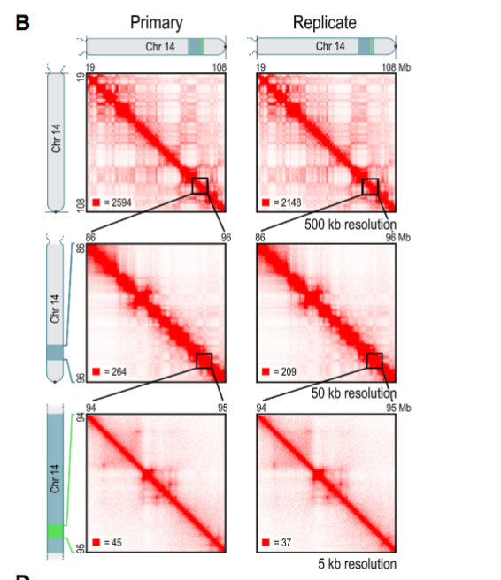

Slide 32
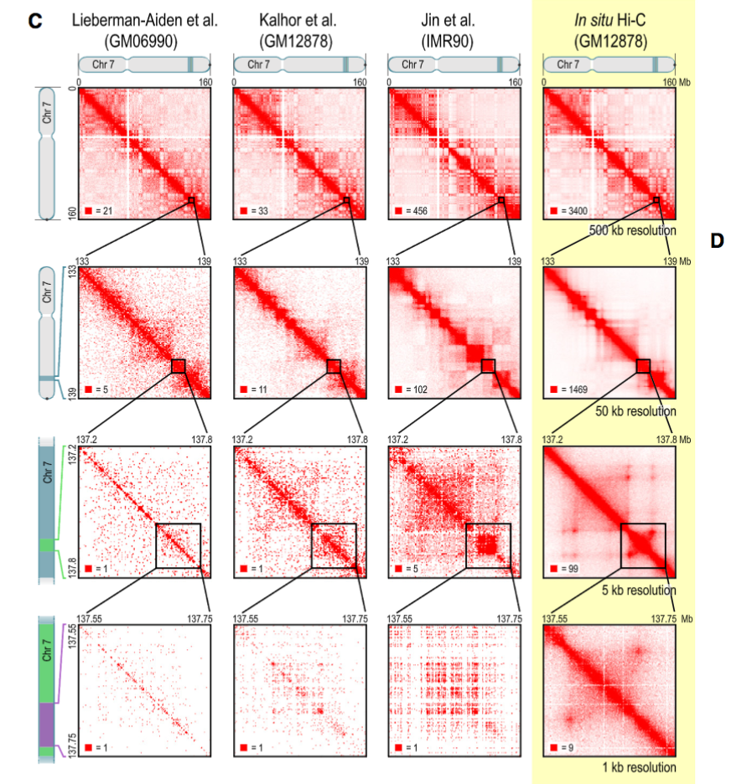

Slide 33
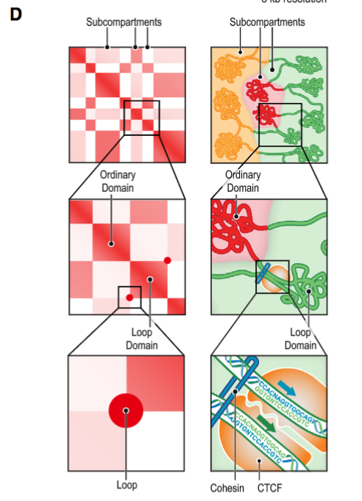

Slide 34
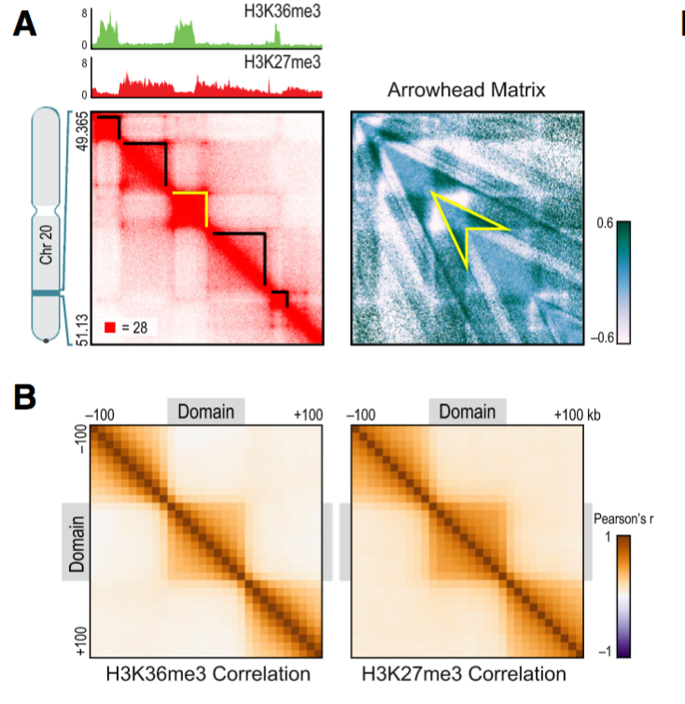
Figure 2

Slide 35
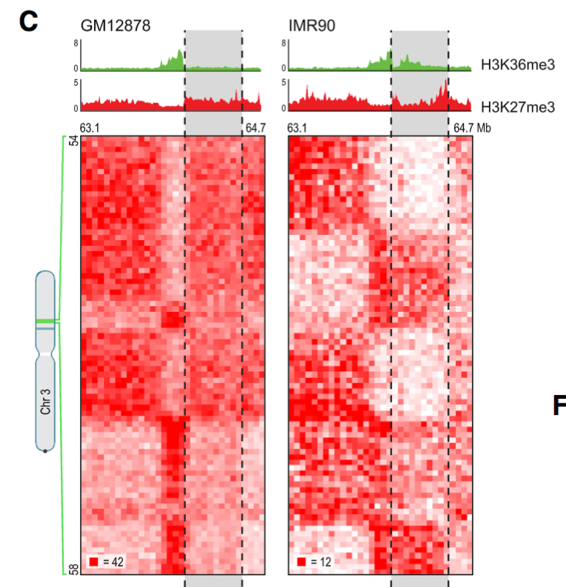
~ Active Transcription
Amplified
Repressed
~ Heterochromatin

Slide 36
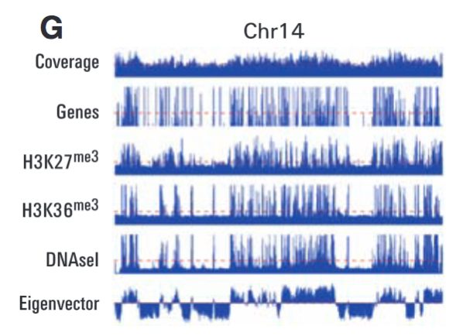

Slide 37
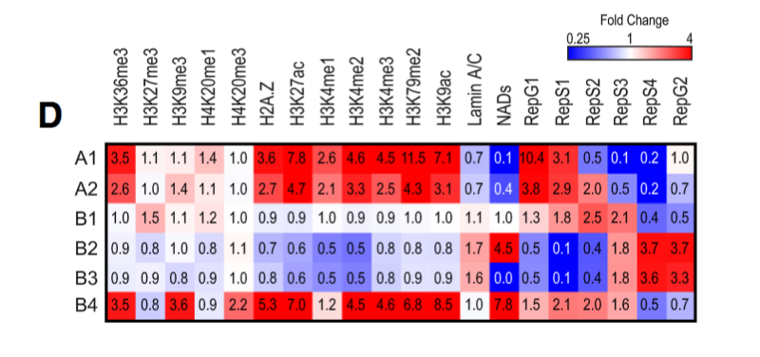
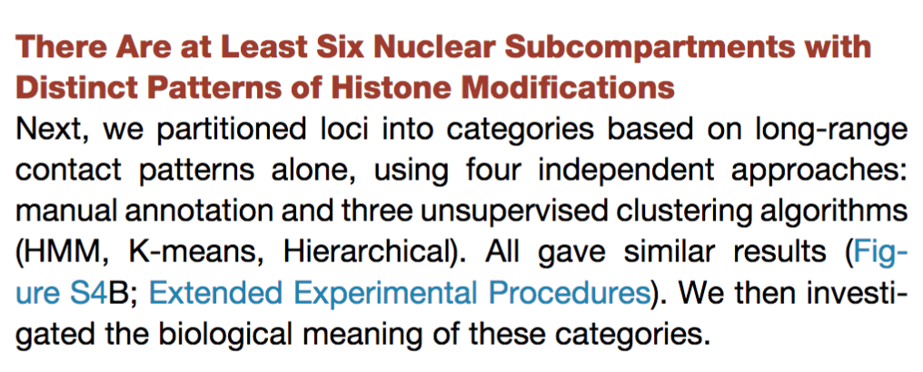

Slide 38
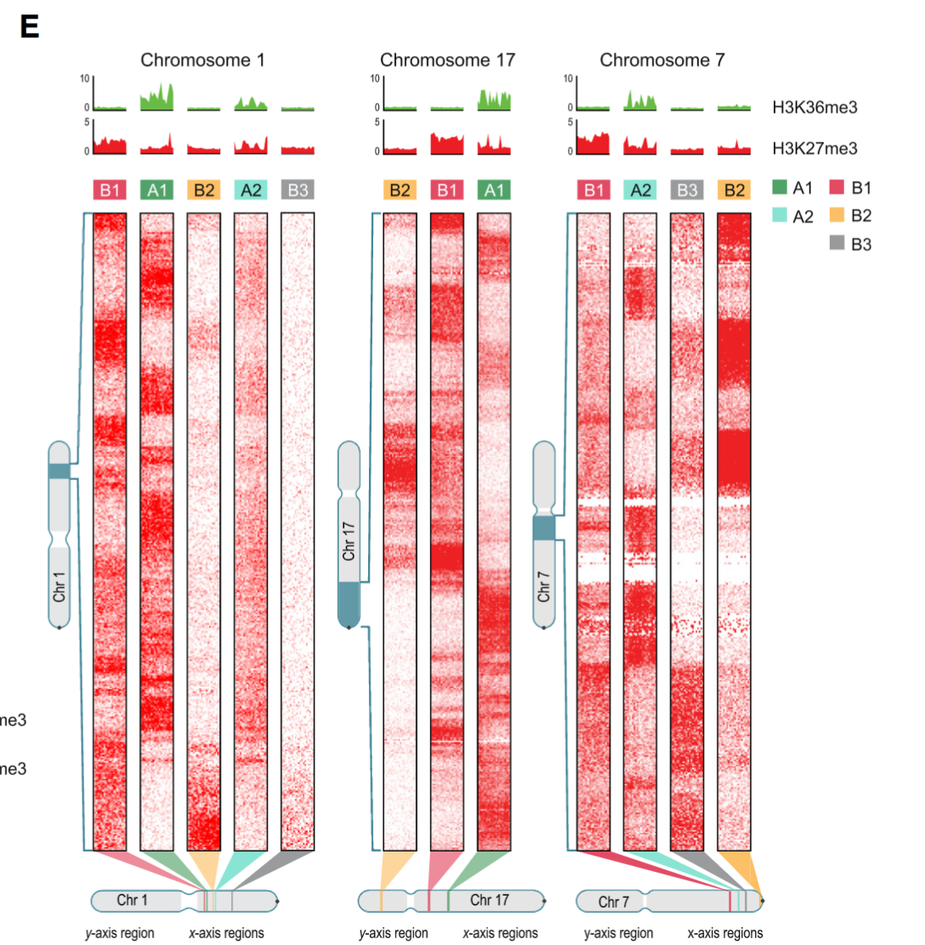

Slide 39
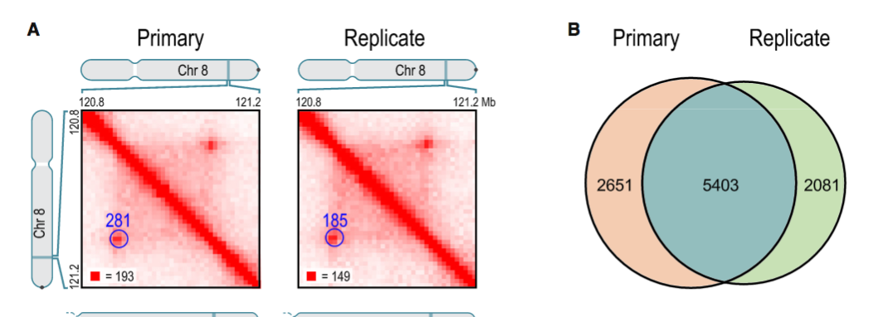
Figure 3

Slide 40
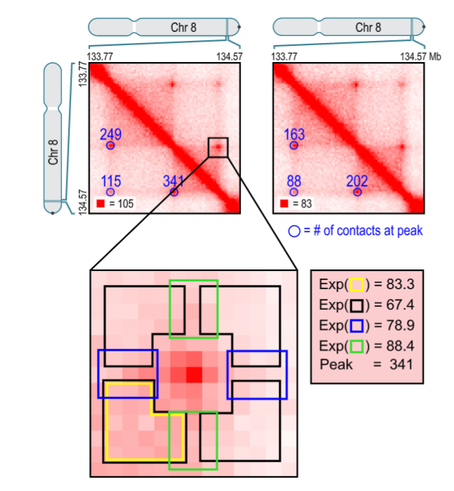

Slide 41
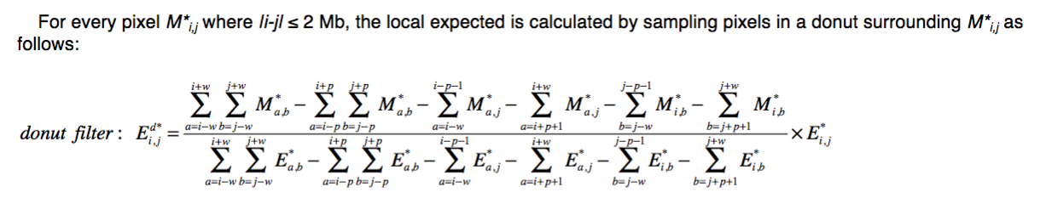
Local background… not global!

Slide 42
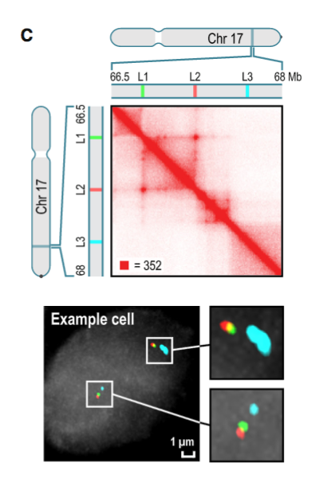

Slide 43
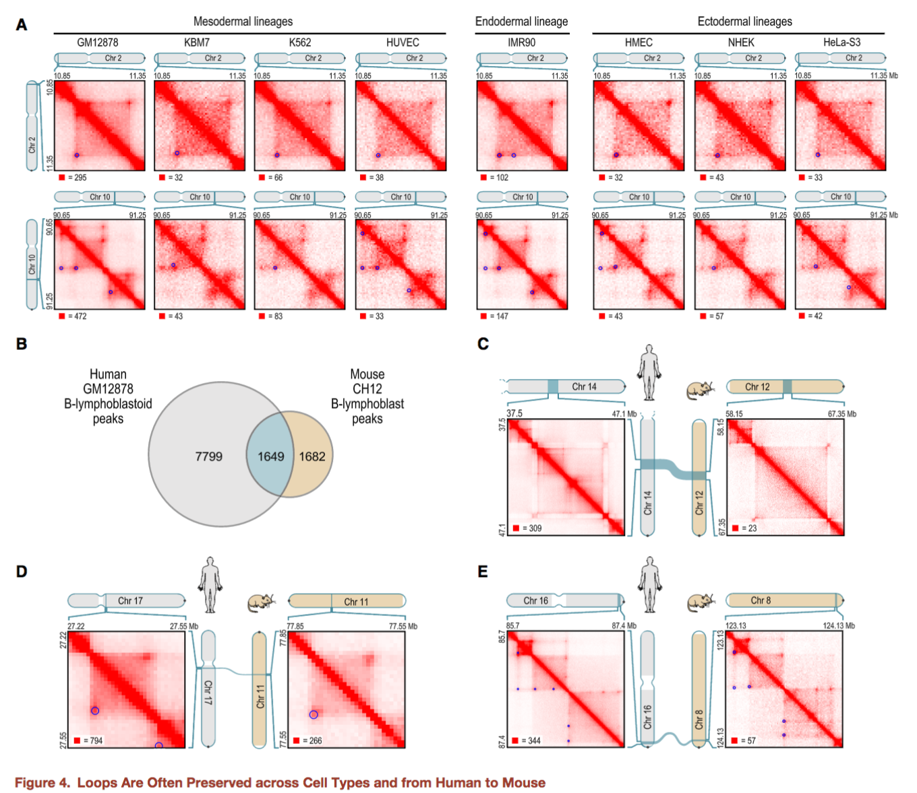
Figure 4

Slide 45
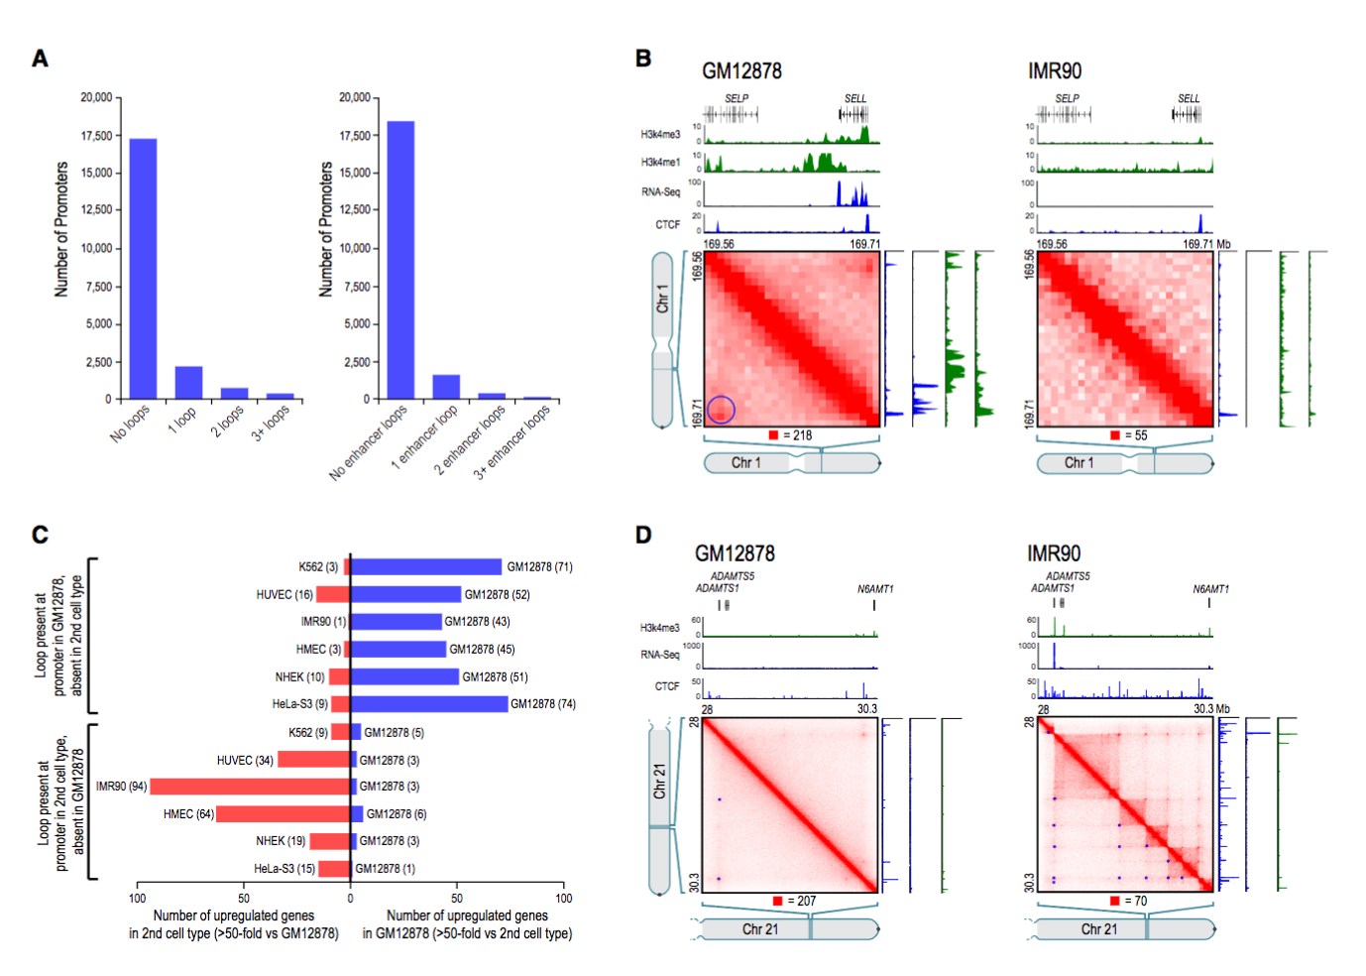
Figure 5

Slide 46
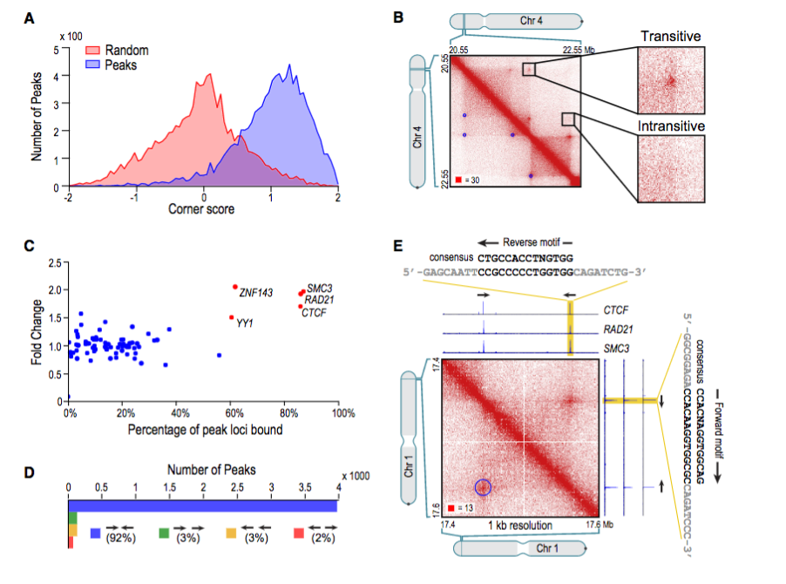
Figure 6

Slide 47
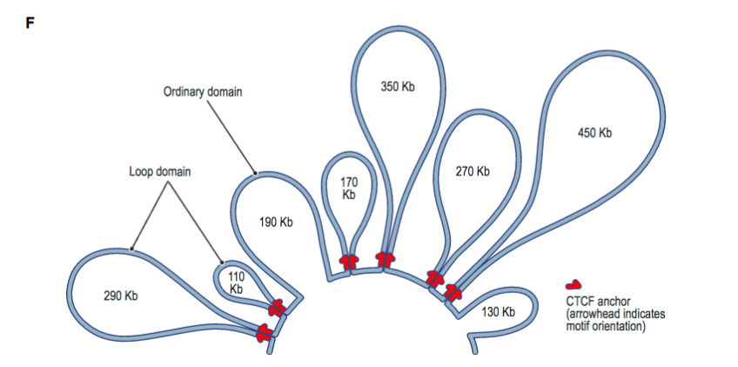

Slide 48
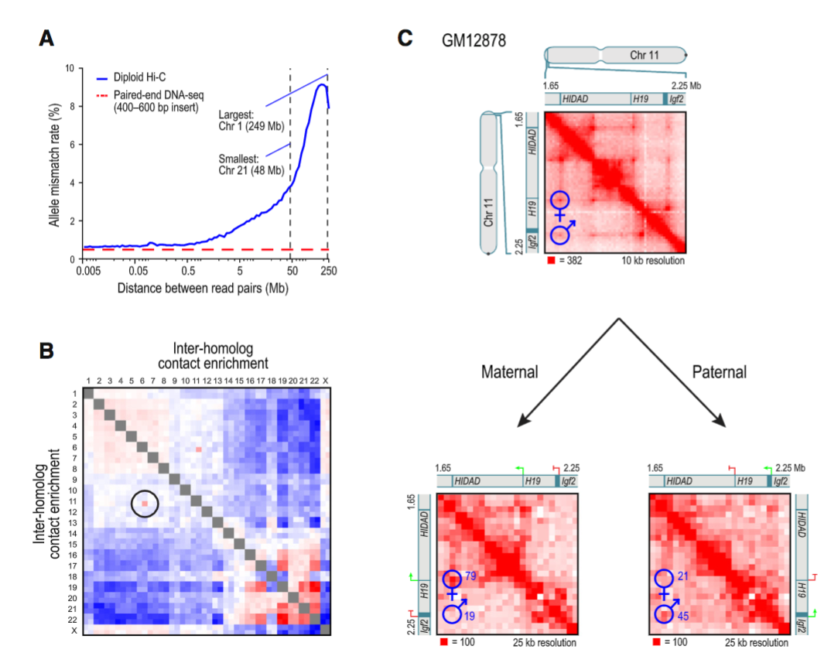
Figure 7

Slide 49
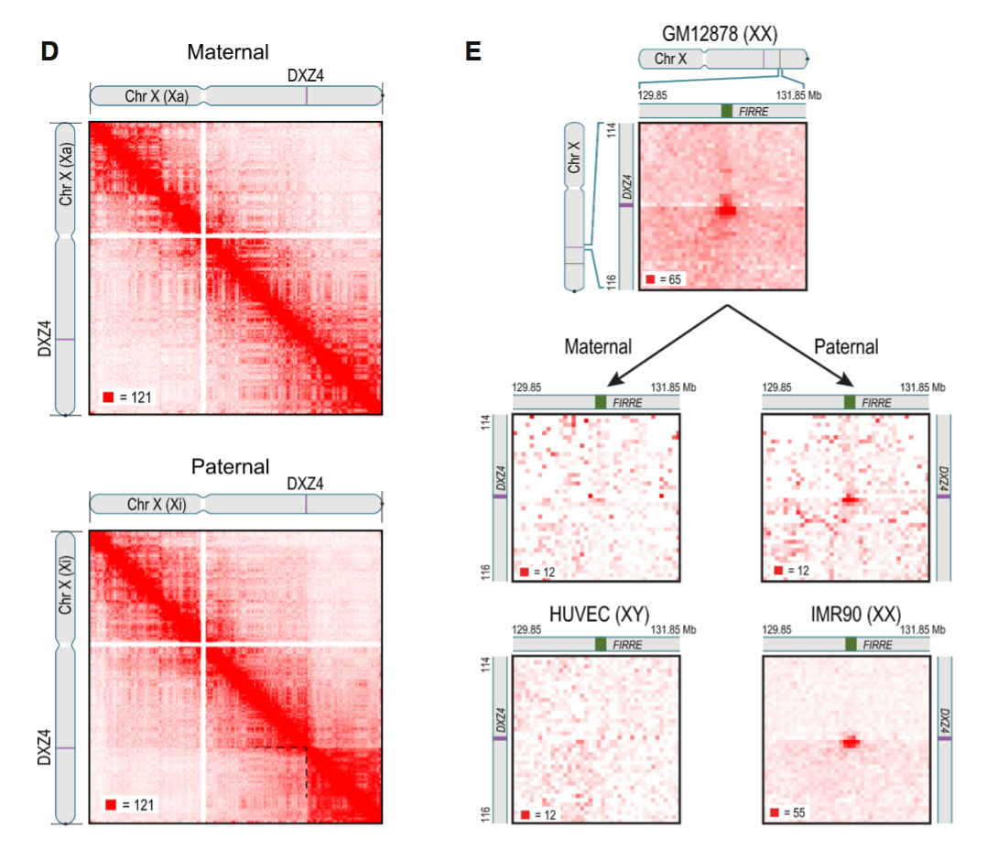

Slide 50
Conclusions
Rao et al. provided the highest resolution mapping of the 3D genome
3D genome important for disease (e.g. carcinogenesis)
Looping techniques aren’t the best
Computational
Experimental

Slide 51
Discussion

